Slide 1
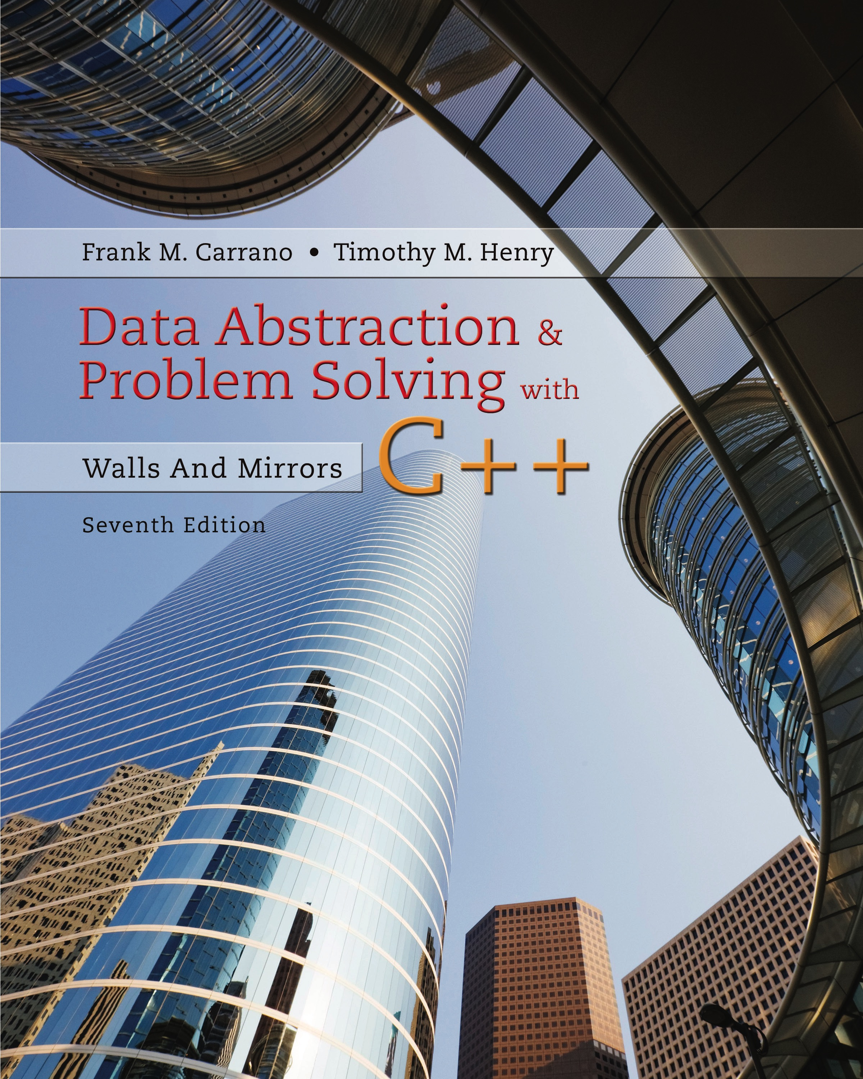
Data Abstraction & Problem Solving with C++: Walls and Mirrors
Seventh Edition
C++ Interlude 5
Class Relationships and Reuse
Copyright © 2017, 2013, 2007 Pearson Education, Inc. All Rights Reserved
Notes:
If this PowerPoint presentation contains mathematical equations, you may need to check that your computer has the following installed:
1) MathType Plugin
2) Math Player (free versions available)
3) NVDA Reader (free versions available)

Slide 2
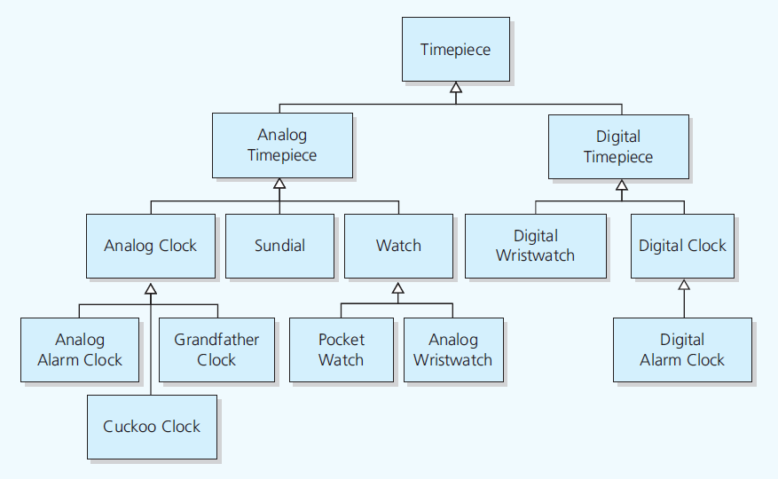
Inheritance Revisited (1 of 8)
Figure C5-1 Inheritance: Relationships among timepieces

Slide 3
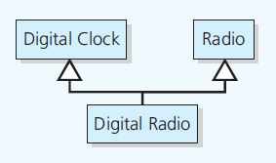
Inheritance Revisited (2 of 8)
Figure C5-2 Multiple inheritance

Slide 4
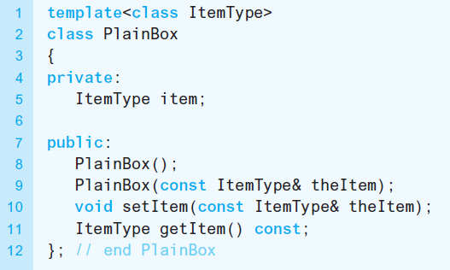
Inheritance Revisited (3 of 8)
Listing C5-1 The class PlainBox, originally given in Listing C1-3

Slide 5
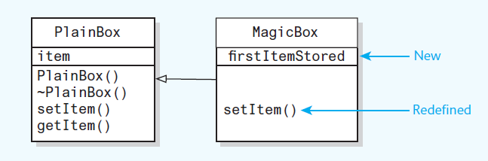
Inheritance Revisited (4 of 8)
Figure C5-3 The derived class MagicBox inherits members of the base class PlainBox and redefines and adds members

Slide 6
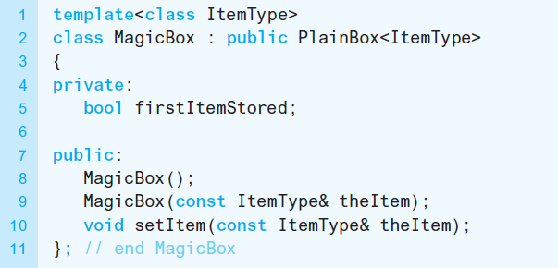
Inheritance Revisited (5 of 8)
Listing C5-2 The class MagicBox, originally given in Listing C1-7

Slide 7
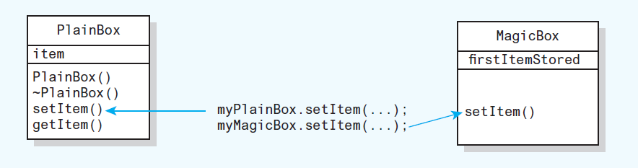
Inheritance Revisited (6 of 8)
Figure C5-4 Early, or static, binding: The compiler determines which version of a method to invoke

Slide 8
Inheritance Revisited (7 of 8)
Late binding
The appropriate version of a method decided at execution time
Polymorphic method has multiple meanings
Virtual method can be overridden
Virtual method in a base class
Virtual in any derived class

Slide 9
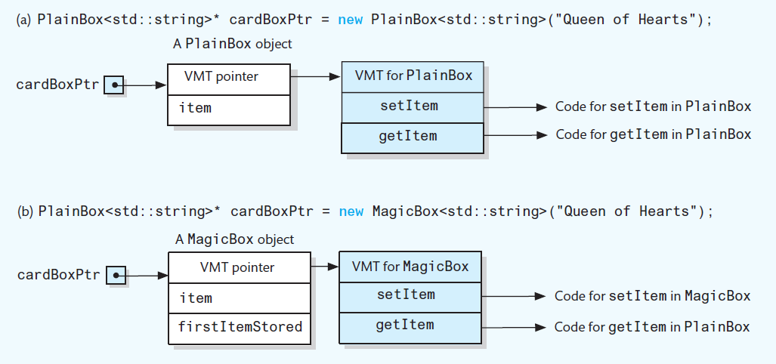
Inheritance Revisited (8 of 8)
Figure C5-5 Virtual method tables when cardBoxPtr points to an instance of either PlainBox or MagicBox

Slide 10
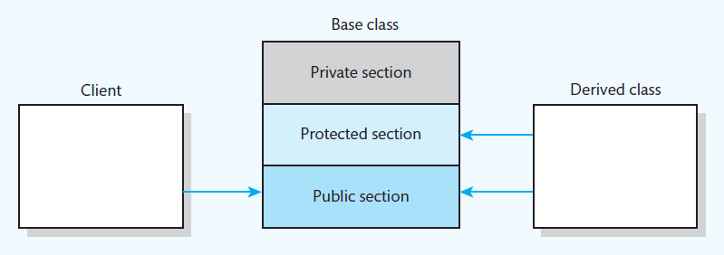
Public, Private, and Protected Sections of a Class
Figure C5-6 Access to public, private, and protected sections of a class by a client and a derived class

Slide 11
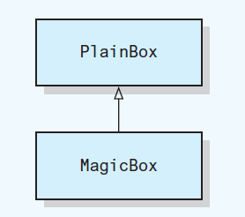
Public, Private, and Protected Inheritance (1 of 2)
Figure C5-7 A magic box is a plain box

Slide 12
Public, Private, and Protected Inheritance (2 of 2)
Public inheritance
Implements is-a relationship
Use instance of a derived class anywhere you can use an instance of base class
If relationship not is-a
Do not use public inheritance

Slide 13
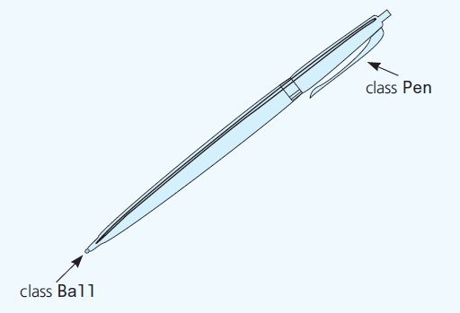
Containment: Has-a Relationships (1 of 3)
Figure C5-8 A pen has a or contains a ball

Slide 14
Containment: Has-a Relationships (2 of 3)
Has-a or containment
Means a class has an object as a data member
Execution order of constructors for both inheritance and containment
Its base class constructor executes.
Constructors of its member objects execute in the declaration order.
The body of its constructor executes.

Slide 15
Containment: Has-a Relationships (3 of 3)
Execution order of destructors for both inheritance and containment
The body of its destructor executes.
Destructors of its member objects execute in the declaration order.
Its base class destructor executes.

Slide 16
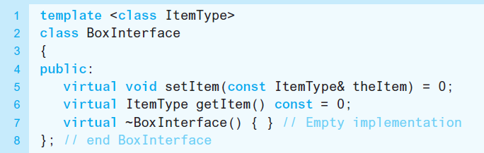
Abstract Base Classes Revisited (1 of 2)
Abstract base class
Contains at least one pure virtual method
Has descendants but no instances
Listing C5-3 An abstract class that is an interface for the A D T box

Slide 17
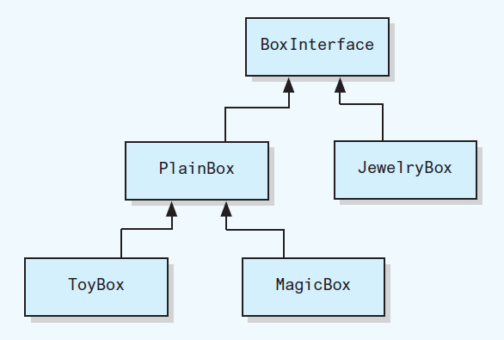
Abstract Base Classes Revisited (2 of 2)
Figure C5-9 U M L class diagram of the family of box classes

Slide 18

Copyright

